Slide 1




Data Communication Concepts
Introduction to IPV4 Address
Lab Three.

Slide 2
Outline
Outline
Overview
Physical Address (MAC address)
Internet Protocol Addressing (IPv4 address)
Address Classes
Internet Private Address
Types of Addresses in an IPv4 Network
Assigning IPv4 address to host

Slide 3
Outline
Overview
In this lab, we will learn about MAC ,IP addresses and how we can assign IP to host to be connected to the network.

Slide 4
Outline
Physical Address (MAC address)
Each device on a network that communicates with others has a unique physical address, sometimes called the hardware address.
On any given network, there is only one occurrence of each address.
For hardware, the addresses are usually encoded into a network interface card (NIC).
In the Data link layer, the analysis of each incoming datagram is performed. If the recipient's address matches the physical address of the device, the datagram can be passed up the layers. If the addresses don't match, the datagram is ignored.

Slide 5
Outline
Physical Address (MAC address)
The length of the physical address varies depending on the networking system, but Ethernet and several others use 48 bits in each address.
For communication to occur, two addresses are required: one each for the sending and receiving devices.
The IEEE is now handling the task of assigning universal physical addresses for sub-networks. For each sub-network, the IEEE assigns an organization unique identifier (OUI) that is 24 bits long, enabling the organization to assign the other 24 bits however it wants.
This address is called MAC (media access control) address.

Slide 6
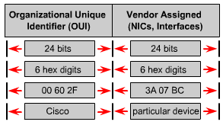
Outline
Physical Address (MAC address)

Slide 7
Outline
Internet Protocol Addressing (IP address)
A unique IP address is required for each host and network component that communicates using TCP/IP.
The IP address is a network layer address and has no dependence on the data-link layer address.
An IP address is a 32-bit number that uniquely identifies a host (computer or other device, such as a printer or router) on a TCP/IP network.
IP addresses are normally expressed in dotted-decimal format, with four numbers separated by periods, such as “192.168.123.132” .

Slide 8
Internet Protocol Addressing (IPv4 address)
Outline
There are two formats for referencing an IPv4 address—binary and dotted decimal notation. Each IPv4 address is 32 bits long and is composed of four 8-bit sections. These 8-bit sections are known as octets. The IPv4 address 192.168.123.132 becomes: 11000000.10101000.01111011.10000100 in binary format.
The decimal numbers separated by periods in the dotted decimal notation are the octets converted from binary to decimal notation. The octets represent a decimal number ranging from zero to 255, and the entire 32 bits of the IP address are allocated to the network and host IDs.

Slide 9
Internet Protocol Addressing (IPv4 address)
Outline
For a TCP/IP WAN to work efficiently as a collection of networks, the routers that pass packets of data between networks do not need to know the exact location of a host for which a packet of information is destined.
Routers only know what network the host is a member of and use information stored in their route table to determine how to get the packet to the destination host's network. After the packet is delivered to the destination's network, the packet is delivered to the appropriate host. For this process to work, an IPv4 address has two parts: a network ID and a host ID.

Slide 10
Internet Protocol Addressing (IPv4 address)
Outline
The network ID identifies the TCP/IP hosts that are located on the same physical network. All hosts on the same physical network must be assigned the same network ID to communicate with each other.
The host ID identifies a host within a network. The host ID must be unique to the network designated by the network ID.
Network ID Host ID
IPv4 Address

Slide 11
Outline
Address Classes
These IPv4 addresses are divided into classes. The most common of these are Classes A, B, and C. Classes D and E exist, but are not generally used by end users. Each of the address classes has a different default subnet mask. You can identify the class of an IPv4 address by looking at its first octet. Following are the ranges of Class A, B, and C Internet addresses, each with an example address:
Class A addresses are assigned to networks with a very large number of hosts. Class A networks use a default subnet mask of 255.0.0.0 and have 0-127 as their first octet. The address 10.52.36.11 is a Class A address. Its first octet is 10, which is between 0 and 127, inclusive.

Slide 12
Outline
Address Classes
Class B addresses are assigned to medium-sized to large-sized networks. Class B networks use a default subnet mask of 255.255.0.0 and have 128-191 as their first octet. The address 172.16.52.63 is a Class B address. Its first octet is 172, which is between 128 and 191, inclusive.
Class C addresses are used for small LANs. Class C networks use a default subnet mask of 255.255.255.0 and have 192-223 as their first octet. The address 192.168.123.132 is a Class C address. Its first octet is 192, which is between 192 and 223, inclusive.

Slide 13
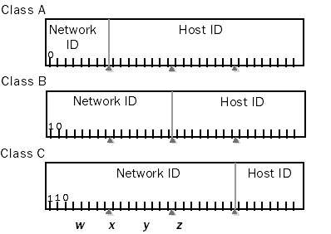
Outline
Address Classes

Slide 14
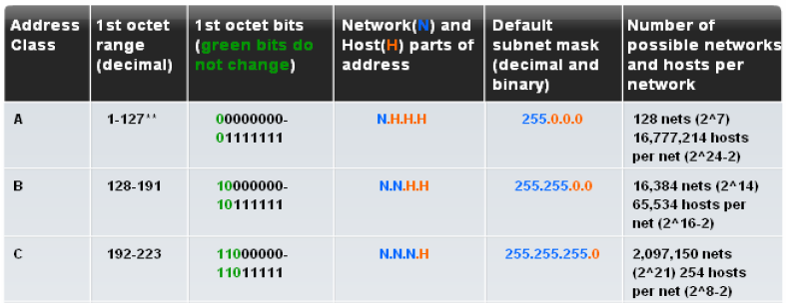
Outline
Address Classes
0

Slide 15
Outline
Internet Private Addresses
A typical small business or home office is allocated a public address (or addresses) from its Internet service provider (ISP), who has received a range of public addresses.
To allow multiple computers in the small office or home office to communicate on the Internet, each computer must have its own public address. This requirement places great stress on the available pool of public addresses.
The range of private address are:
10.0.0.0 -10.255.255.255.255.
172.16.0.0 – 172.31.255.255.
192.168.0.0 – 192.168.255.255.

Slide 16
Outline
Internet Private Addresses
Private addresses cannot receive traffic from Internet locations. Therefore, if an intranet is using private addresses and communicating with Internet locations, the private address must be translated to a public address.
A network address translator (NAT) is placed between an intranet that uses private addresses and the Internet, which uses public addresses.
Outgoing packets from the intranet have their private addresses translated by the NAT into public addresses. Incoming packets from the Internet have their public addresses translated by the NAT into private addresses.

Slide 17
Outline
Types of Addresses in an IPv4 Network
Network Address
The network address is a standard way to refer to a network. All hosts in a network such as 10.0.0.0 network will have the same network bits. Within the IPv4 address range of a network, the lowest address is reserved for the network address. This address has a 0 for each host bit in the host portion of the address.
Broadcast Address
The IPv4 broadcast address is a special address for each network that allows communication to all the hosts in that network. To send data to all hosts in a network, a host can send a single packet that is addressed to the broadcast address of the network. The broadcast address uses the highest address in the network range. This is the address in which the bits in the host portion are all 1s.

Slide 18
Outline
Types of Addresses in an IPv4 Network
Host Addresses
As described previously, every end device requires a unique address to deliver a packet to that host. In IPv4 addresses, we assign the values between the network address and the broadcast address to the devices in that network.

Slide 19

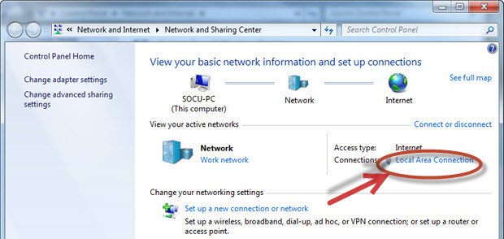
Assigning IPv4 address to host
Outline
We can assign IPv4 address statically to host as illustrated in the following steps:
Go to the Network icon and then to Network and
Sharing Center.
2. Select the Change Adapter Settings option.

Slide 20
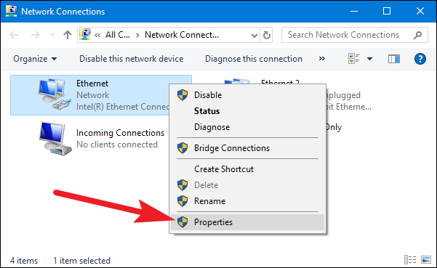
Assigning IPv4 address to host
Outline
3. Select the connected network such as local area network.

Slide 21
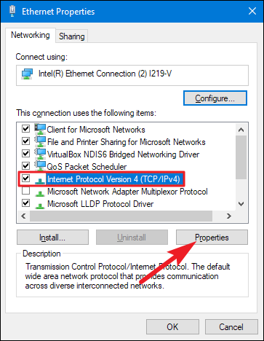
Outline
Assigning IPv4 address to host
4. Select the Internet Protocol Version 4 (TCP/IPv4) option and go to Properties icon.

Slide 22
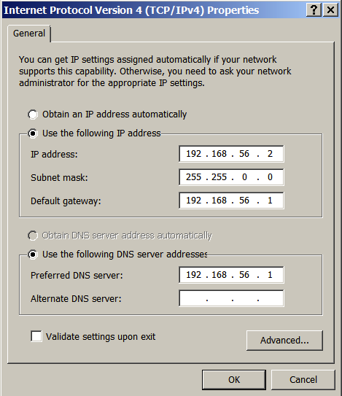
Assigning IPv4 address to host
Outline
5. Select the ‘Use the following IP address ‘ and filled the IP address, subnet mask and default gateway parameters.

Slide 23


THANK YOU

